Slide 1
Microbial Diversity, Abundance and Community Composition in Frass-Treated Bulk Soil and Rhizosphere
Bacteria and Fungi
Shaphan Yong Chia, Pedro Beschoren da Costa, Joop J.A. van Loon and Marcel Dicke

Slide 2
Key microbial taxa that demonstrated significant responses and associations with the different treatments and conditions (Preliminary !!!)
Bacterial Taxa:
Firmicutes (Bacilli and Paenibacilli): Composted frass increased their abundance in bulk soil and rhizosphere.
Paenibacilli: Uncomposted frass showed a higher abundance of paenibacilli than composted frass.
Bacillaceae: Frass dose (5 g/kg) led to elevated populations of Bacillaceae in bulk soil, particularly in response to frass amendments.
Chitinophagaceae: Chitinophagaceae showed a significant increase in response to frass supplementation.
Alpha and Gamma Proteobacteria: Adding 5 g/kg frass increased the abundance of alpha and gamma proteobacteria.
Chloroflexi: 5 g/kg frass addition increased the abundance of Chloroflexi.
Fungal Taxa:
Ascomycota: Composted frass increased Ascomycota abundance in bulk soil and rhizosphere.
Mortierellomycetes (Mortierella): Uncomposted frass showed a higher abundance of Mortierellomycetes in the rhizosphere.
Sordariomycetes (including Metarhizium), Eurotiomycetes (including Penicillium), and Mortierellomycetes (Mortierella) were the most important predictors of plant biomass in bulk soil and rhizosphere.
These taxa responded to composted and uncomposted frass amendments, frass dose levels, and variations between bulk soil and rhizosphere conditions. They played a role in shaping the microbial community structure and potentially influencing plant biomass in the context of frass treatments.
Note: These are some of the key taxa highlighted by the study, and the full analysis might provide additional insights into the microbial taxa responses.

Slide 3
Results
Title:
Plant and soil effects…..
Content:
Plant biomass stuf…
RF R2, RMSE as main (maybe part of ABCD; justifies focus on bulk soil bacteria, bacilales, chitonofagales)
RF heat trees taxonomies as supplementary
Title:
Frass treatments strongly impact microbial community composition
OR
Frass source and dose dominate shifts in microbial community
Content:
NMDS with control samples as main
NMDS of frass-only as supplementary
PERMANOVA table without controls as supplemtnary
Alpha diversity with tests as….
main if we want to highlight suppression of fungi
Supplementary is we do not want to highlight
Title:
Order Bacillales and Chitinophagales are key features in community shifts
Content:
Heatmaps (ABCD) showing differentially abudannt taxa on order level as supplmentary
Heattree of pairwise comparsions (X vs Y, C vs U, 2 VS 5) for bulk as main
Heattree of pairwise comparsions (X vs Y, C vs U, 2 VS 5) for rhizosphere as suplementary
The other heat tree set will be supplementary
Heat tree matrices as supplementary of comparsions
All fungi differentially abundant ASVs as supplementary

Slide 4
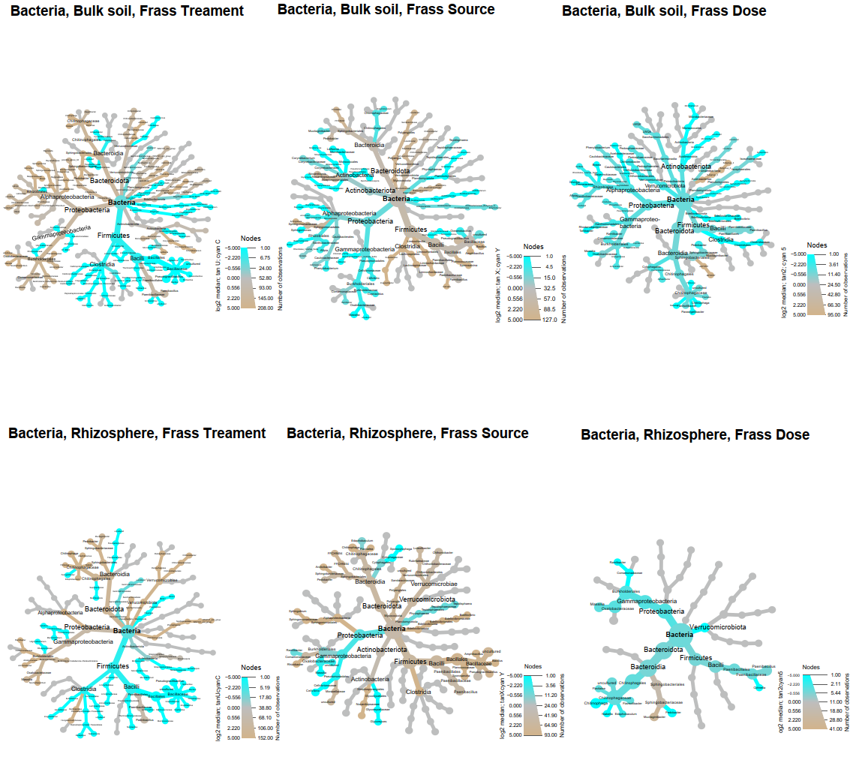
Hierarchical heat tree of bacterial taxa abundance in bulk soil and rhizosphere: composted and uncomposted frass amendment
Composted frass clearly increased the abundance of firmicutes (including bacilli and paenibacilli), in both bulk soil and rhizosphere
The paenibacilli, however, was more abundant in the uncomposted frass than in the composted frass
Frass dose, influenced by complex interactions, showed elevated populations of common taxa (including bacillaceae, chitinophagacaea, etc.) at 5 g/kg, particularly in bulk soil as opposed to rhizosphere.
Figure 1
Either rhizosphere or bulk soil as main, the other as supplementary

Slide 5
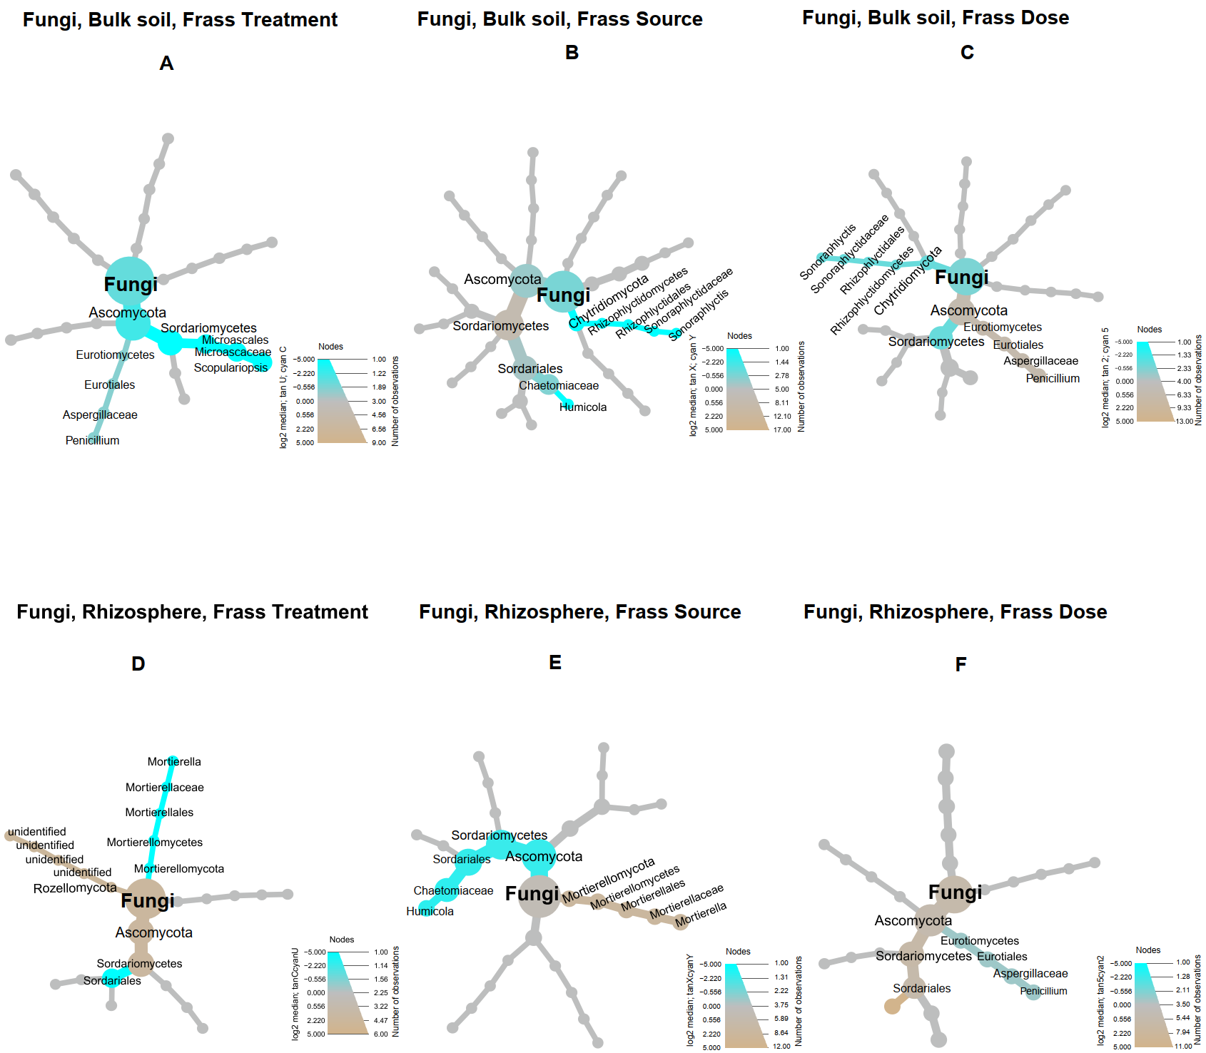
Hierarchical Heat Tree of Fungal Taxa Abundance in Bulk Soil and Rhizosphere: Composted and Uncomposted Frass Amendment
Composted frass (frass treatment) increased the abundance of Ascomycota in both the bulk soil and rhizosphere
Frass source Y exhibited a higher abundance of Ascomycota compared to frass source X in both bulk soils and rhizosphere
Uncomposted frass showed a higher abundance of Mortierellomycetes (including Mortierella) in the rhizosphere than composted frass
Higher dose 5 promotes Ascomycota abundance more than dose 2, in both bulk soils and the rhizosphere
Figure S

Slide 6
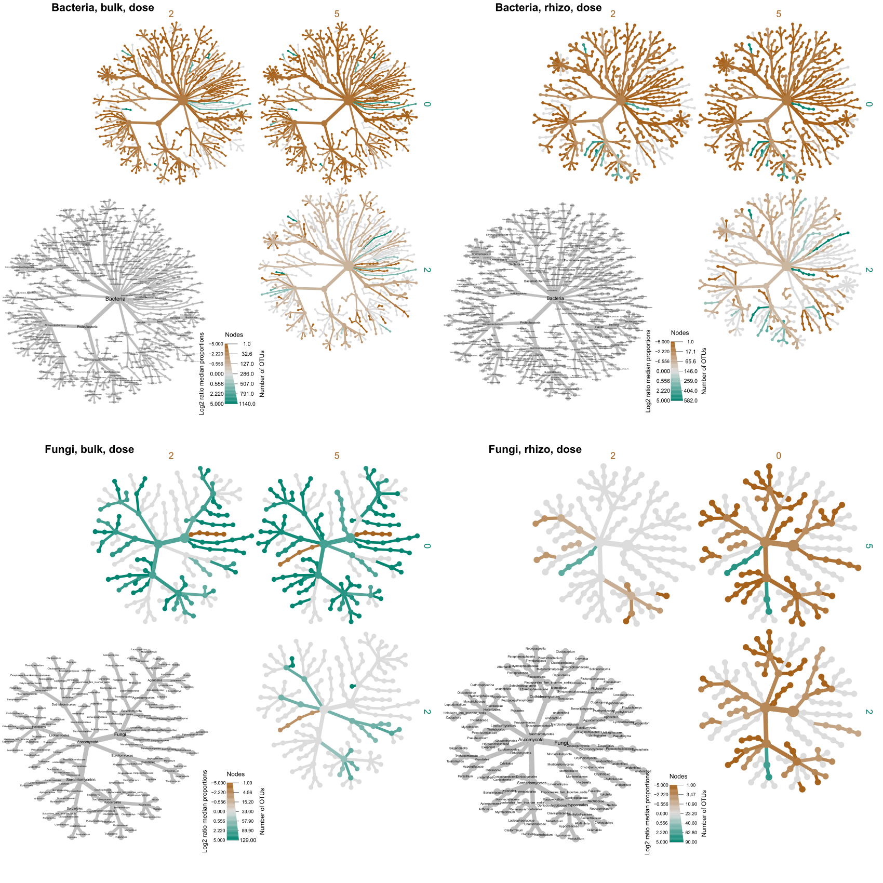
Heat tree analysis of bacterial taxa abundance across frass dose levels (0, 2, and 5 g/kg)
Adding frass to the soil at 5 g/kg led to a higher abundance of bacteria groups such as alpha and gamma proteobacteria, Chloroflexi and firmicutes (including bacilli) than 0 (no-frass) and 2 g/kg.
Chitinophagaceae showed a marked increase in response to frass supplementation
Figure S

Slide 7
Heat tree analysis of fungal taxa abundance across frass dose levels (0, 2, and 5 g/kg)
Frass dose was not the primary factor influencing fungal communities in both bulk soil and rhizosphere samples, as shown in the NMDS (beta diversity) analysis
Figure S

Slide 8
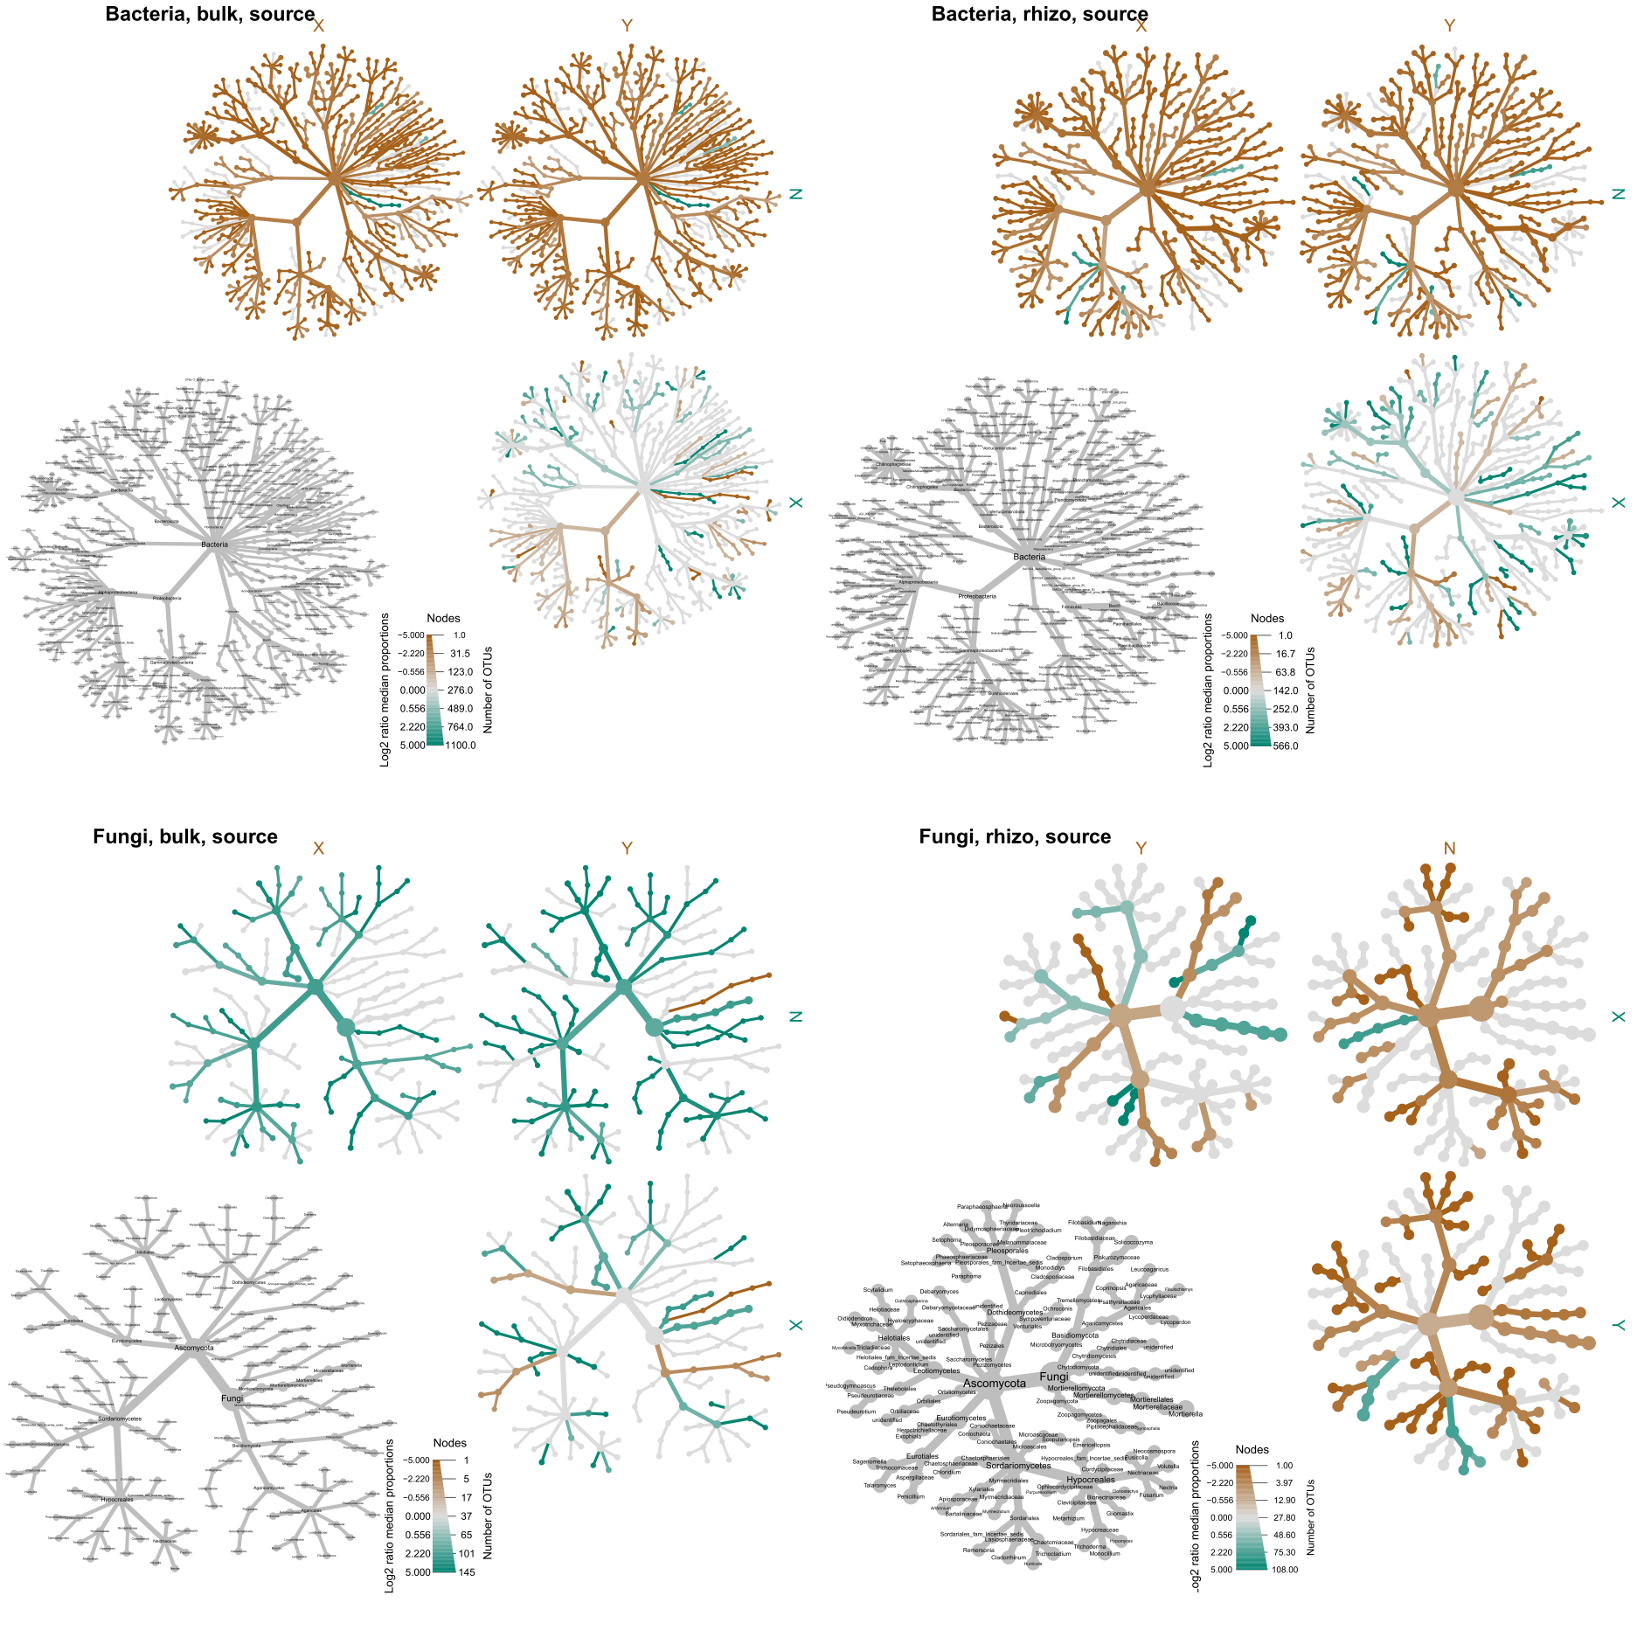
Heat tree analysis: bacterial taxa abundance in bulk soil, rhizosphere and frass sources (X, Y)
Adding frass (X and Y) significantly increased the abundance of bacterial taxa in both bulk soil and rhizosphere compared to no-frass (N)
Bacillaceae and Chitinophagaceae are among the major groups that are stimulated
Differences in the abundance of bacterial taxa between frass sources X and Y are visible
Figure S

Slide 9
Heat tree analysis: fungal taxa abundance in bulk soil, rhizosphere and frass sources (X, Y)
Adding frass (X and Y) markedly reduced the abundance of fungal taxa in both bulk soil and rhizosphere compared to no-frass (N)
Figure S

Slide 10
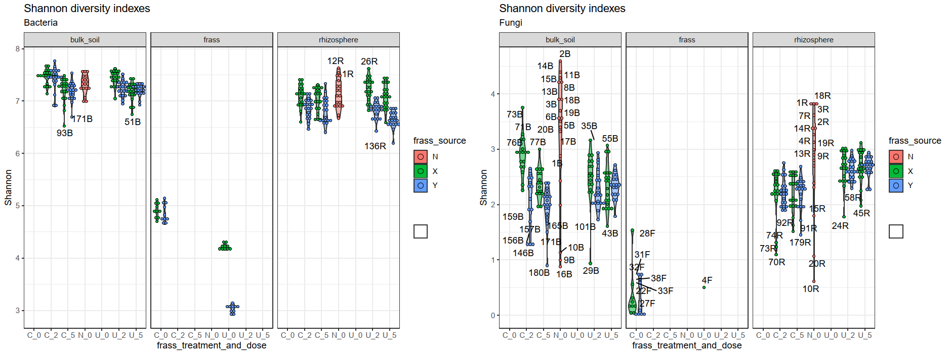
Shannon diversity index analysis of bulk soil, frass and rhizosphere bacterial and fungal microbiome: comparison between frass treatment (C, U) and source (N-nofrass, X, Y)
Frass application significantly decreased fungal diversity in both bulk soil and rhizosphere samples
Frass-only (frass) samples had lower bacterial and fungal diversity than bulk soil and rhizosphere samples

Slide 11
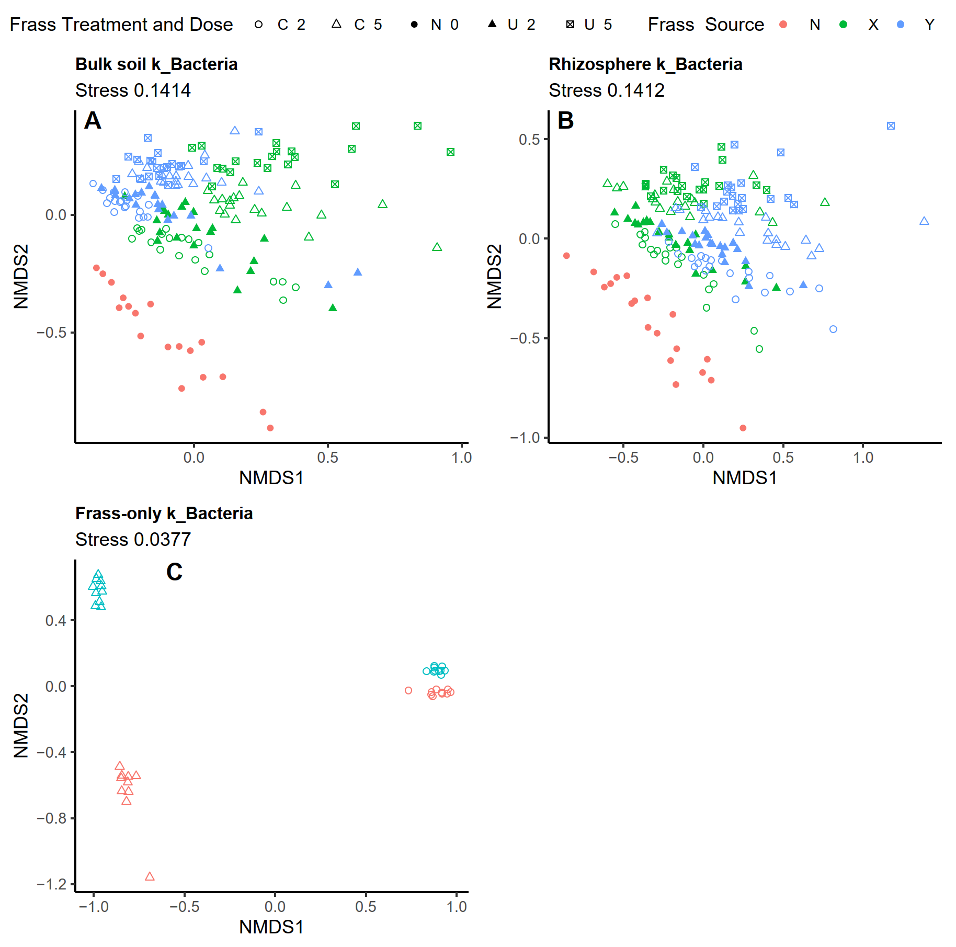
NMDS plot: bacterial community similarities/dissimilarities – bulk soil, rhizo. and frass-only samples
Distinct separation of the no-frass (N) from the frass amendments (X, Y) (see Fig. A and B)
Frass dose (2 and 5 g/kg) is the main contributing factor to this separation
Composting frass significantly increased the similarity of bacterial communities (see Fig. C).
However, noticeable dissimilarities between sources X and Y are still discernible
Figure 1
ABCD for bac/fun rhizo/bulk as main. Leave frass-only sample as supplementary (AB for Bac/Fun) [shaphan]

Slide 12
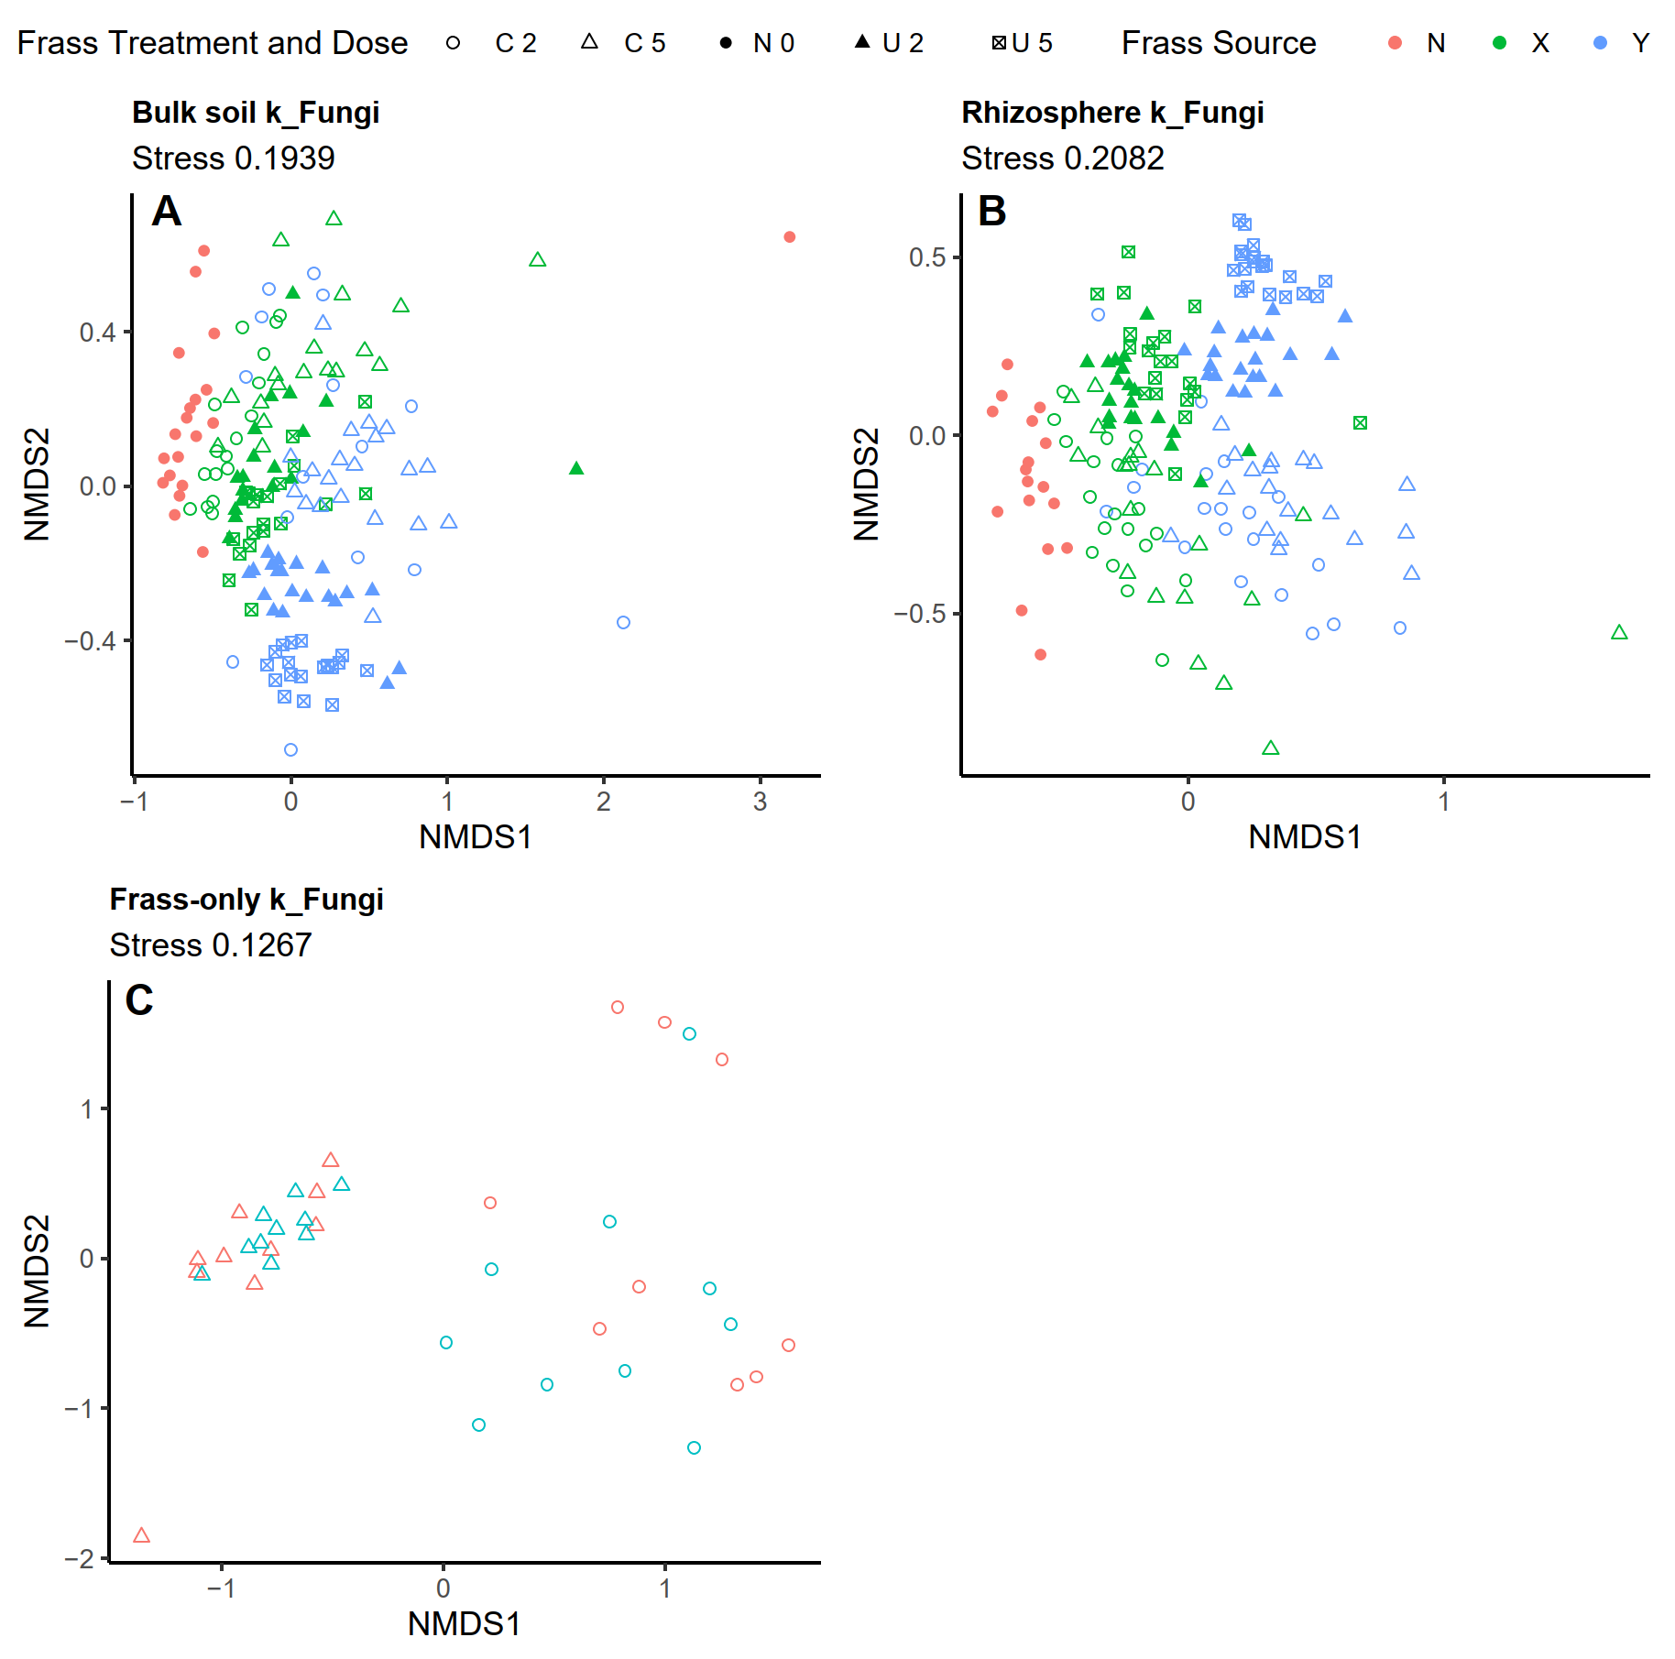
NMDS plot: fungal community similarities/dissimilarities – bulk soil, rhizo. and frass-only samples
Distinct separation of the no-frass (N) from the frass amendments (X, Y) (see Fig. A and B)
Frass source (N, X, Y) is the main contributing factor to this separation
Notable dissimilarities between composted and uncomposted frass (Fig. C)
However, such dissimilarities are not apparent when comparing the different frass sources.
differentiation among the fungal communities is less pronounced compared to the bacterial communities

Slide 13
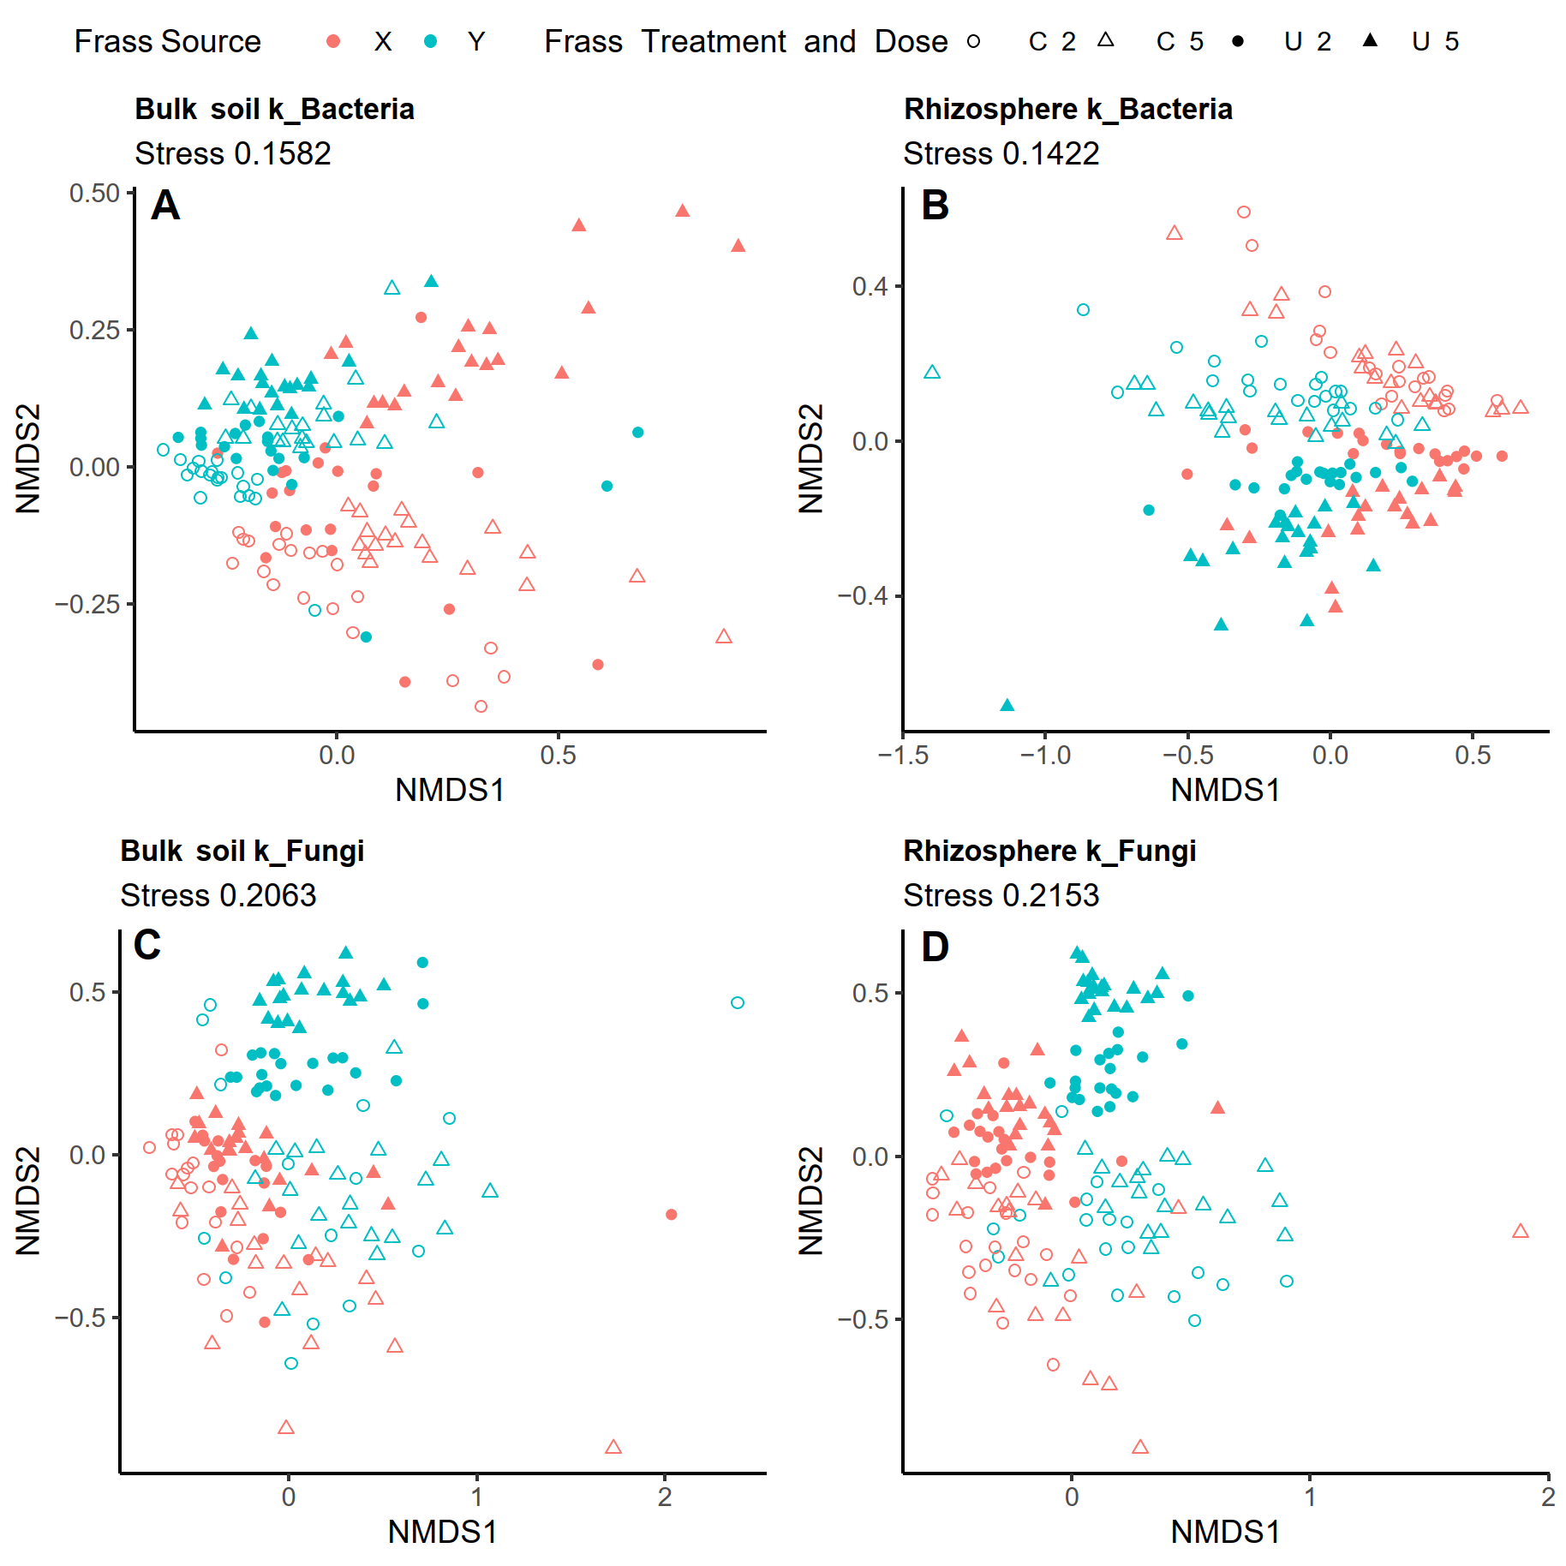
NMDS plot: bacterial and fungal community similarities/dissimilarities – bulk soil and rhizo. samples
Significant three-way interactions, suggesting that all factors examined (frass treatment, frass source, and dose) play important roles in shaping the microbial community structure
Main effect of frass source determined the bacterial community structure of bulk soil
Main effect of frass treatment determined bacterial community structure in the rhizosphere
In bulk soil samples, composting has a more pronounced impact on the fungal community of frass source Y and the bacterial community of frass source X
KEEP STATISTICS OF THESE MODELS WIHTOUT THE CONTROL, BUT DO NOT PUBLISH THIS FIGURES WIHOUT THE CONTROL

Slide 14
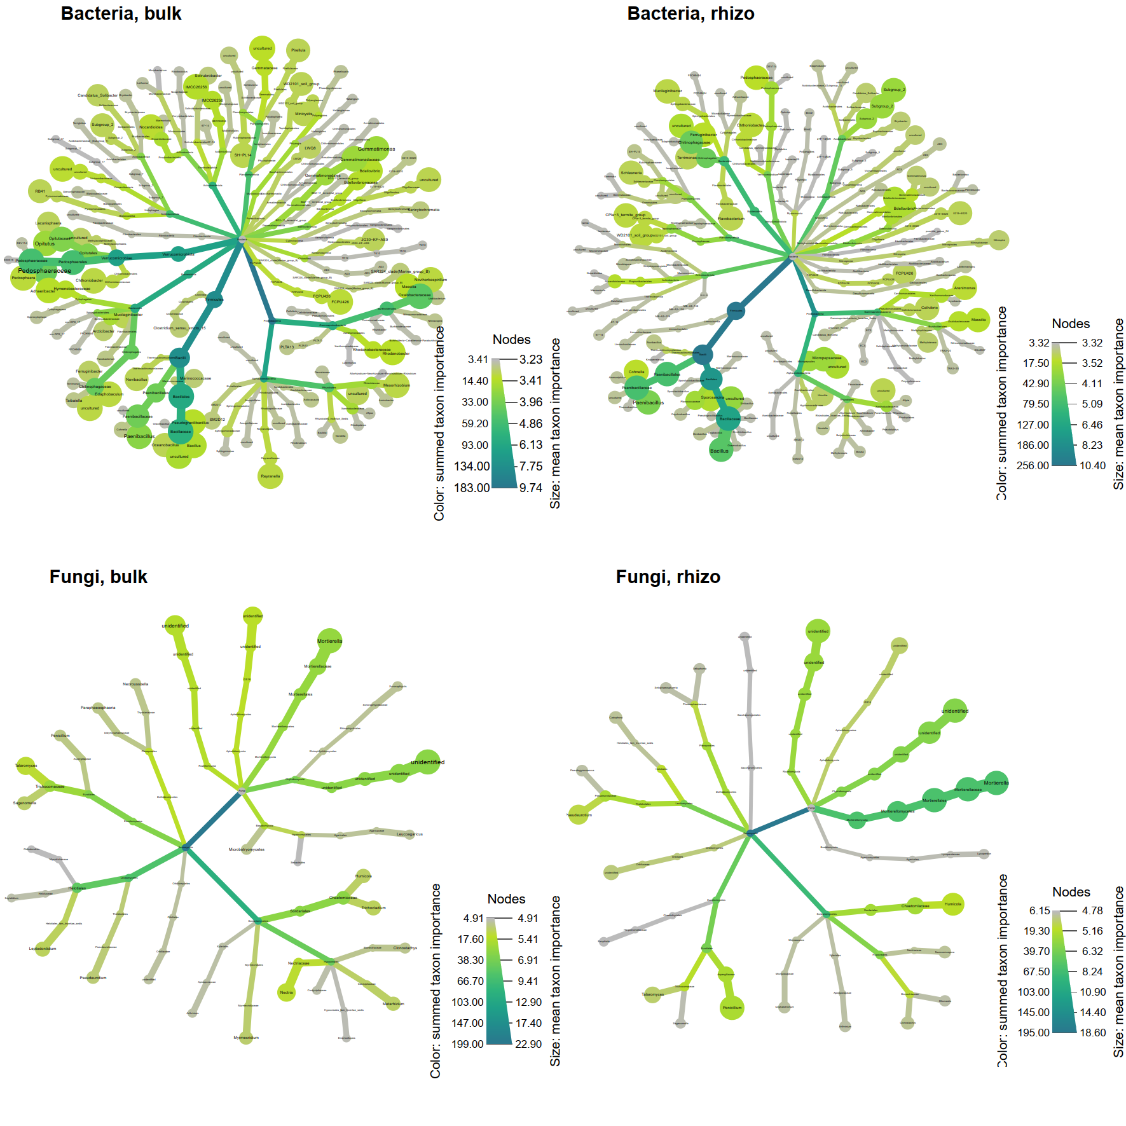
Microbial taxa impacting Brassica rapa plant biomass prediction: random forest feature importance analysis
In both bulk soil and rhizosphere, the presence of Bacilli taxa (including Bacillus and Paenibacillus) emerges as a significant predictor of plant biomass in B. rapa
Among the beneficial fungi in both bulk soil and rhizosphere, Sordariomycetes (including Metarhizium), Eurotiomycetes (Penicillium), and Mortierellomycetes (Mortierella) emerge as important predictors of plant biomass
Figure s

Slide 15
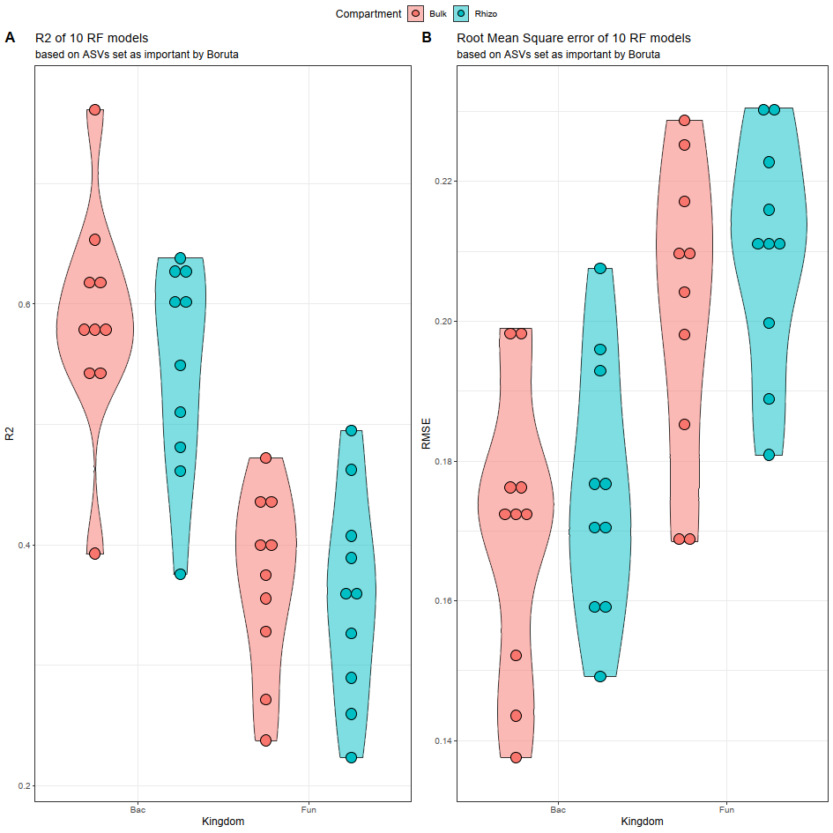
Comparative predictive performance of random forest models for bacterial and fungal data in plant biomass prediction across bulk soil and rhizosphere
Random Forest (RF) models demonstrate superior predictive performance for bacterial data (high R², low RMSE values) compared to fungal data in relation to plant biomass
Particularly, the models exhibit higher efficacy when applied to bulk soil samples (bacteria)
RMSE = root mean square error; Bac = bacteria; Fun = fungi

